Slide 1
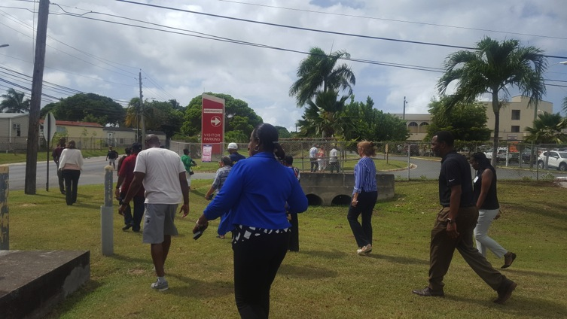
USVI Walkability Action Institute
_
Post-institute webinar
August 2017
WAI participants completing an ambitious walk audit near the hospital, St. Croix .

Slide 2
The 2017 USVI Walkability Institute is made possible through a partnership with TEPHINET, a program of The Task Force for Global Health (TFGH), the Centers for Disease Control and Prevention (CDC), and the USVI Department of Health (USVIDOH). Its contents are the sole responsibility of the authors and do not necessarily represent the views of The Task Force for Global Health, Inc., TEPHINET, or the CDC.

Slide 3
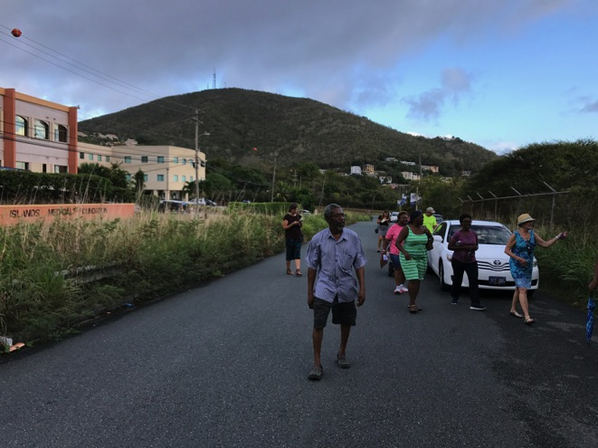
Topics:
The goal: from projects to policy!
Epi-Aid data – using it to make the case.
Discuss island action plans.
Next steps, further TA.
St. Thomas walk audit

Slide 4
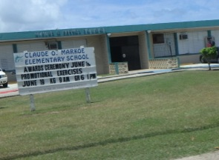
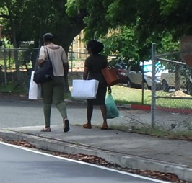
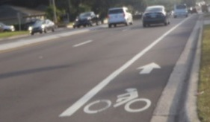
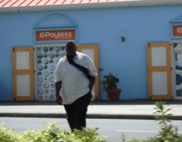
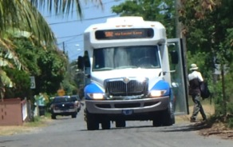
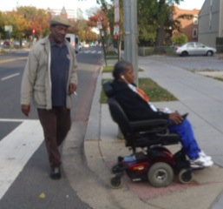
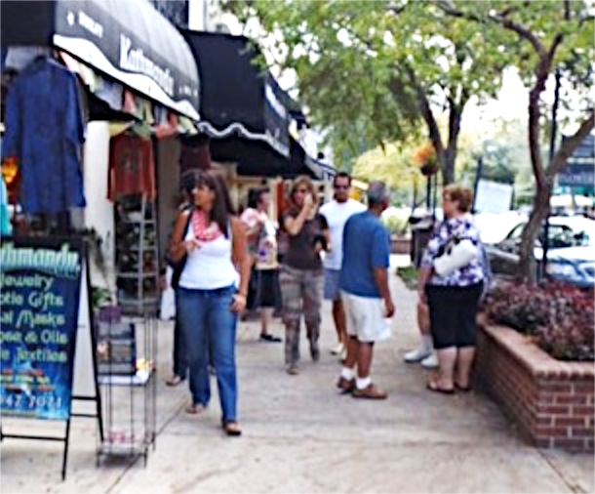
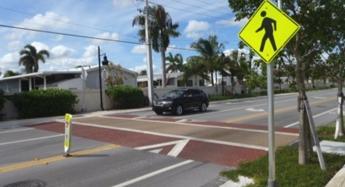
Environment: settings supporting active transportation!
Destinations
Network
Safety & Access
Site Design

Slide 5
The “stealth” team:
Bike/Ped
Advocate
Trails
Elected
Rec.
Transport
Planning
Parks
Enviro.
DPW
Vision
Job
Reach
Neighbor-
hoods
Housing
NAR
Transit
Banks
Developer
NAHB
Chamber
Chamber
Schools
Employers
Health
PTOs
Hospital
Insurer
AARP
Found.
Churches
Service
Orgs.
ACS
AHA

Slide 6
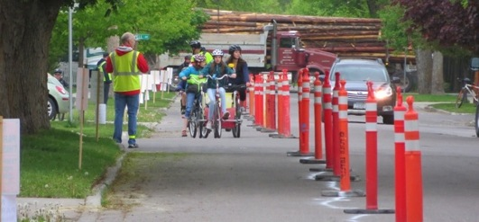
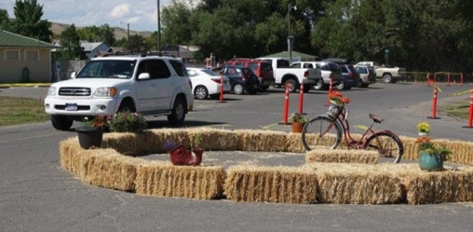
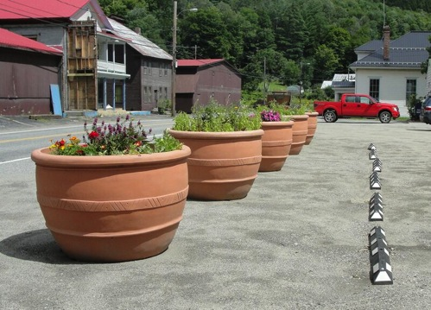
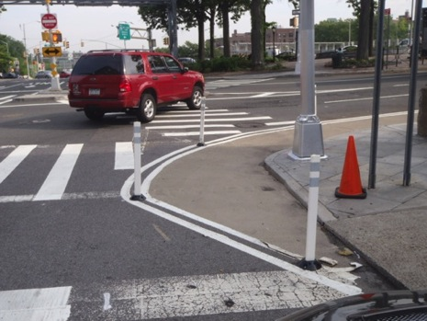
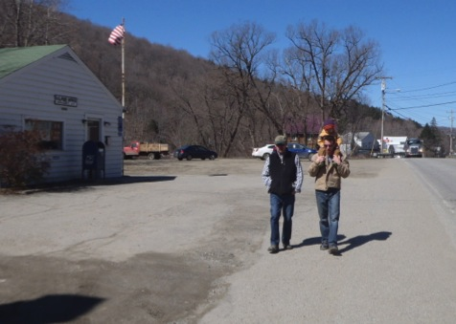
Trials, pilots & demonstration projects build momentum.
Curb stops & planters

Slide 7
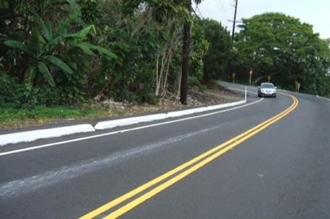
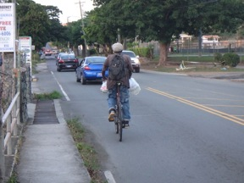
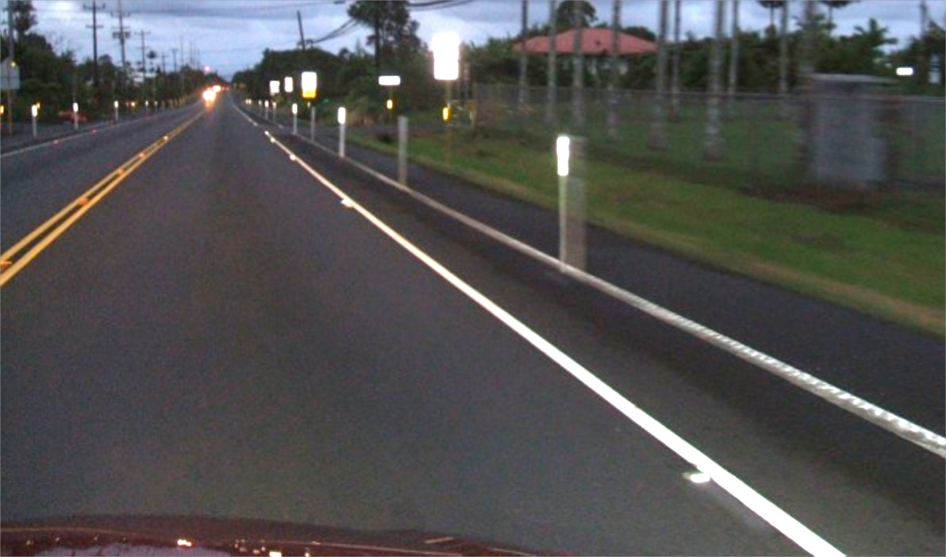
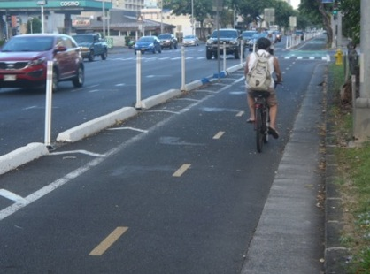
Goal: Policies & practices that make these designs the standard!

Slide 8
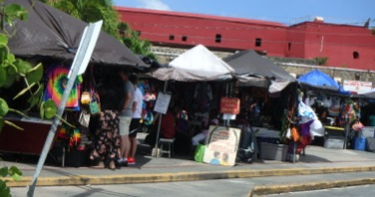
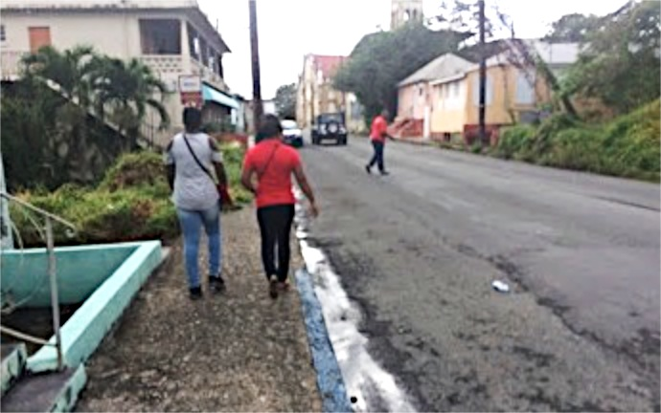
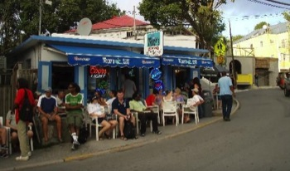
The big “policy” ideas . . .
Create villages, centers.
Connect them with Complete Streets & transportation trails.
Design details to be safe, functional, and inviting for pedestrians (& cyclists) of all ages, abilities, incomes.

Slide 9
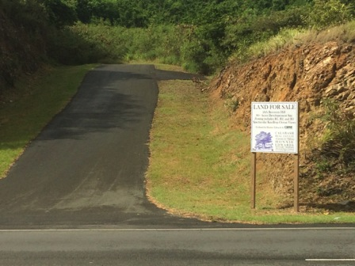
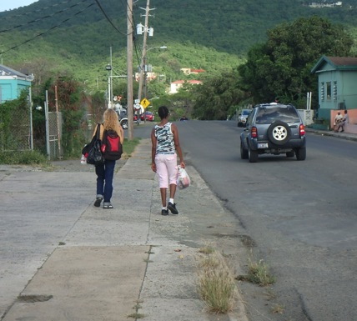
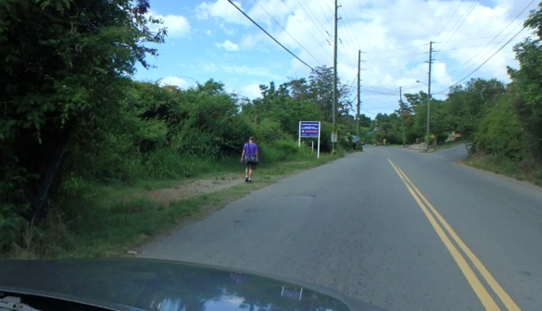
Development close to existing centers & services.
Safe, accessible, & inviting for everyone.
Well connected for all users.

Slide 10
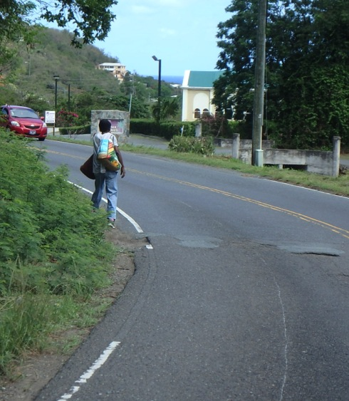
Questions for each action plan:
Are you convening the stealth team?
Will the demo project make a difference?
What are the bigger policy & practice goals?
Are the plan & demo project moving you toward those goals?
A common challenge

Slide 11
Availability of Street-Level Supports for Walking — US Virgin Islands, 2016
Emily Ussery, PhD, MPH
John Omura, MD, MPH
Physical Activity and Health Branch
Centers for Disease Control and Prevention

Slide 12
Questions
What purposes can walkability audits serve?
What was the goal of the USVI walkability audit?
How did we choose which streets to audit? Why did we do it this way?
How can data from the USVI walkability audit be used…and what are its limitations?

Slide 13
What purposes can walkability audits serve?
Planning tool to identify and characterize specific problem areas in a community
Advocacy tool to raise awareness among community stakeholders and promote community engagement
Surveillance tool to systematically assess the prevalence of built environment features in a defined area

Slide 14
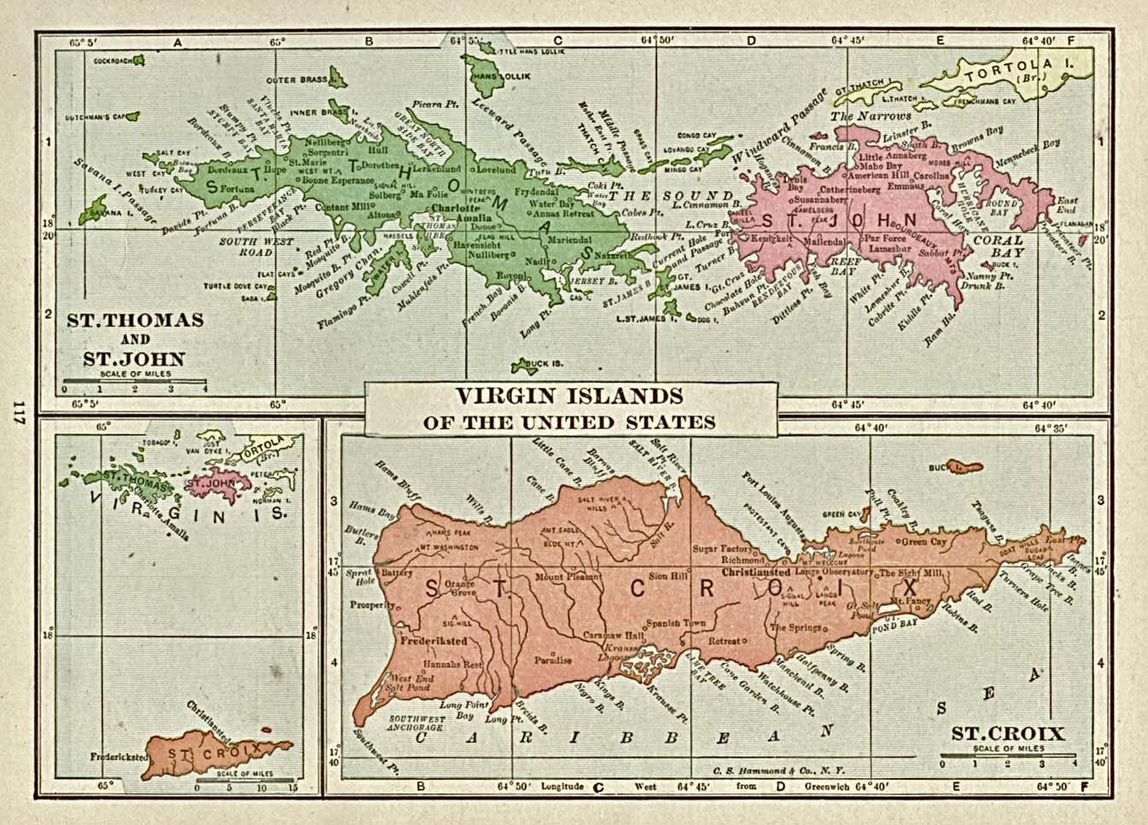
What was the goal of the USVI walkability audit?
To collect data on community design features to describe the walkability of streets across the USVI

Slide 15

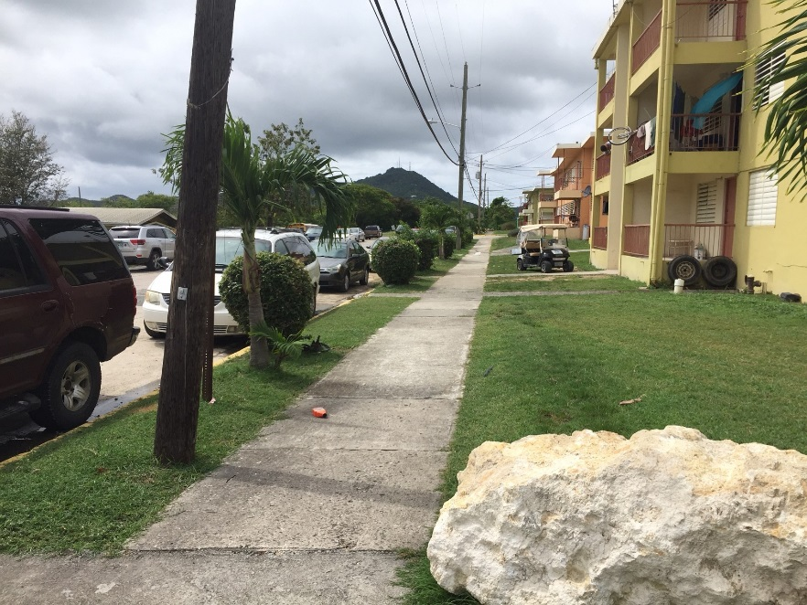
How did we choose which streets to audit?
Why did we do it this way?
“50% of American adults get enough physical activity…”
What percentage of street length in the USVI has sidewalks?

Slide 16
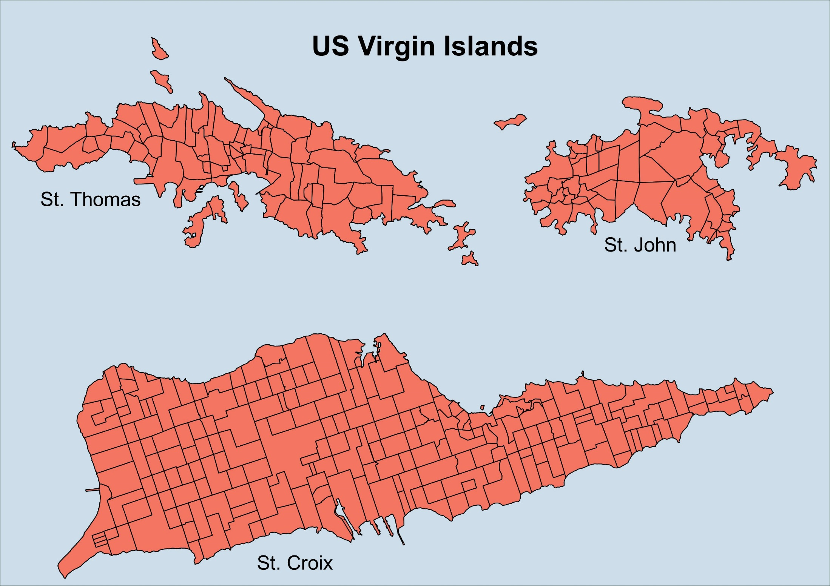
Total:
336 Estates

Slide 17
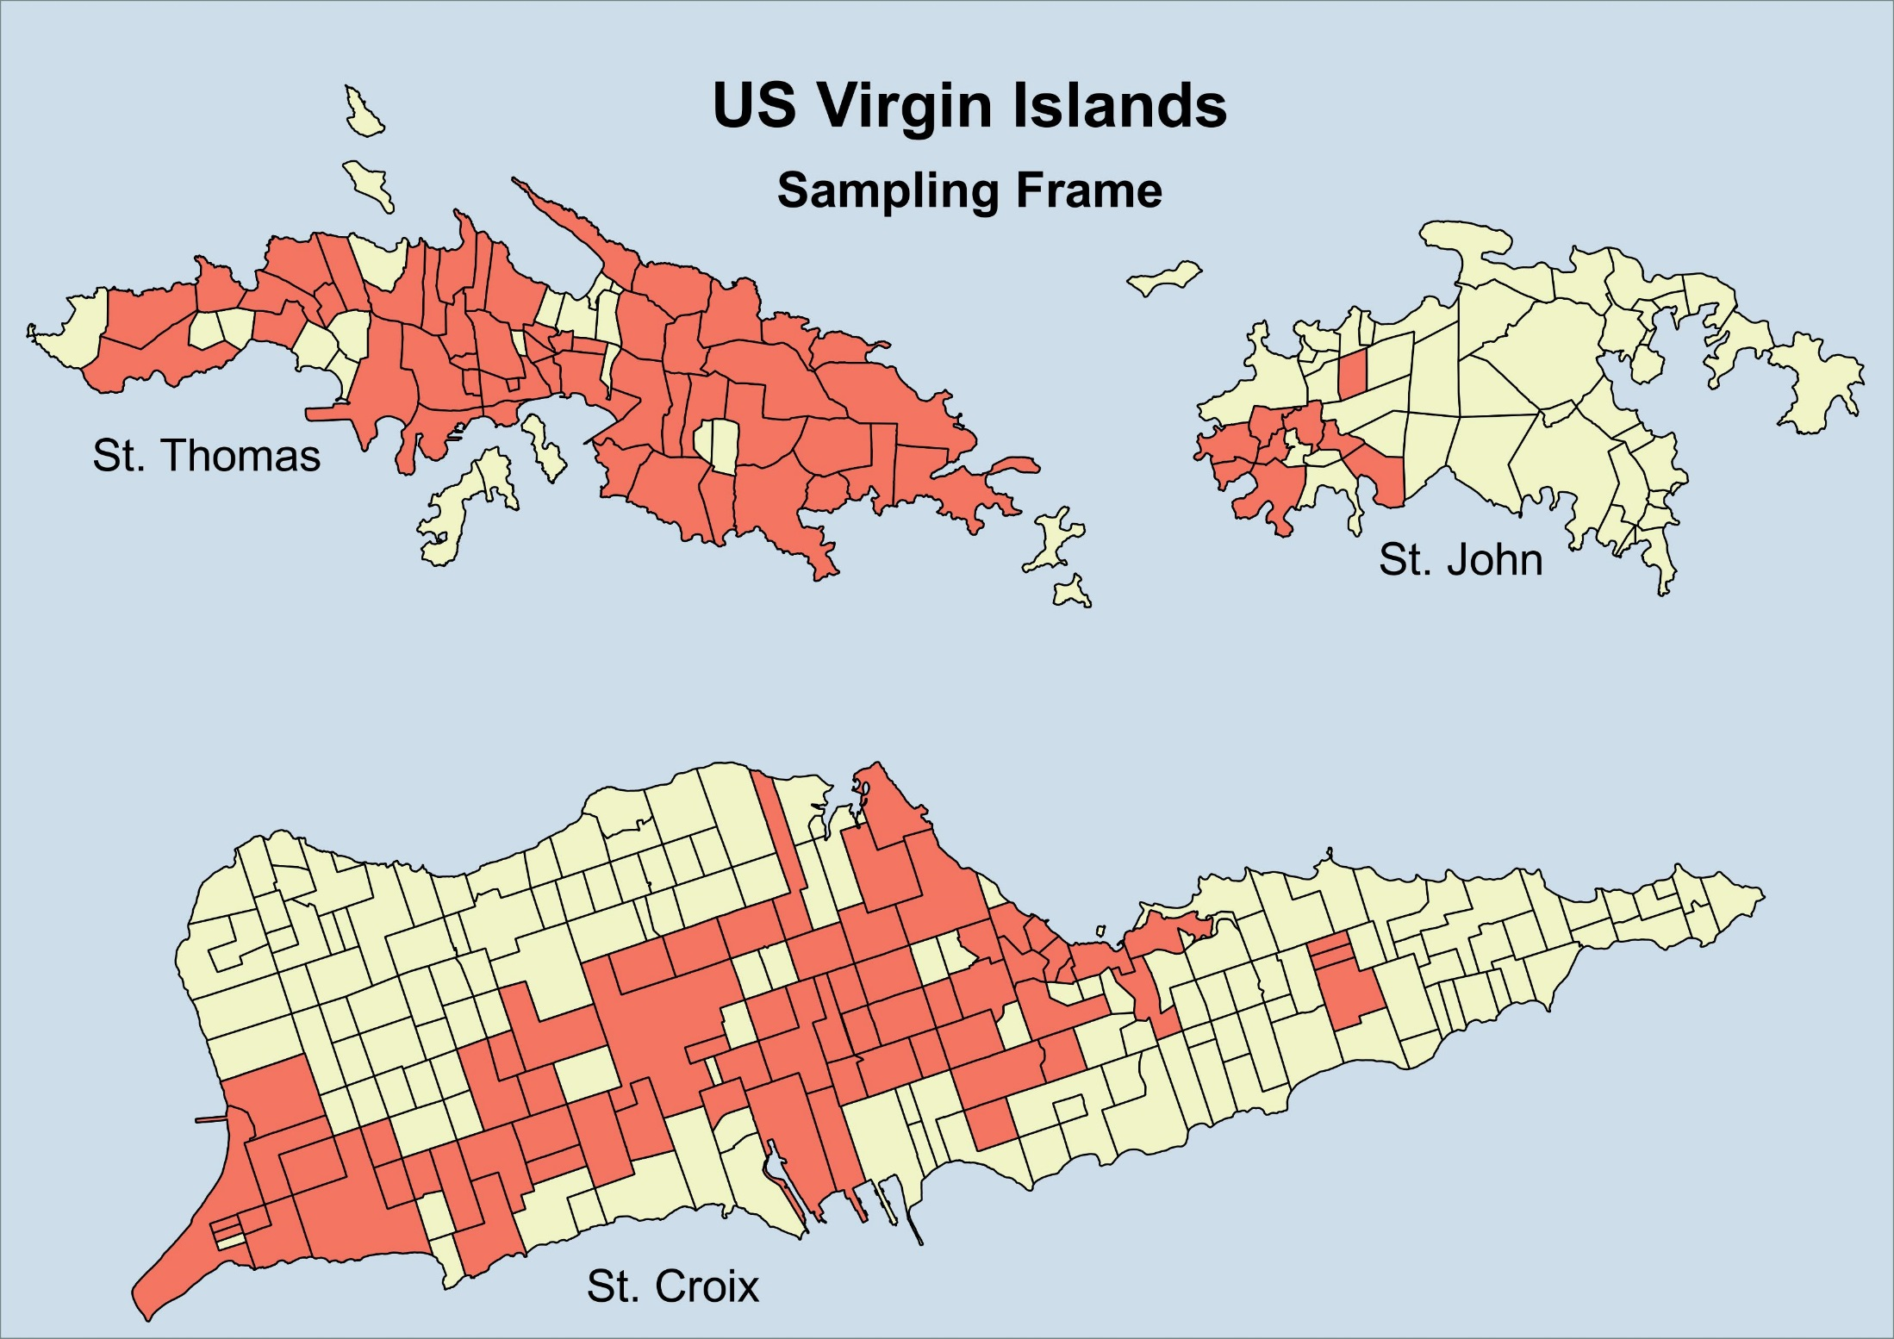
Sampling Frame:
126 Estates

Slide 18
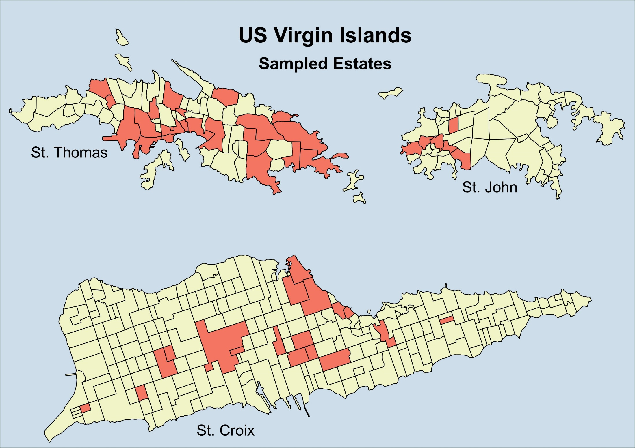
Sample:
46 Estates

Slide 19
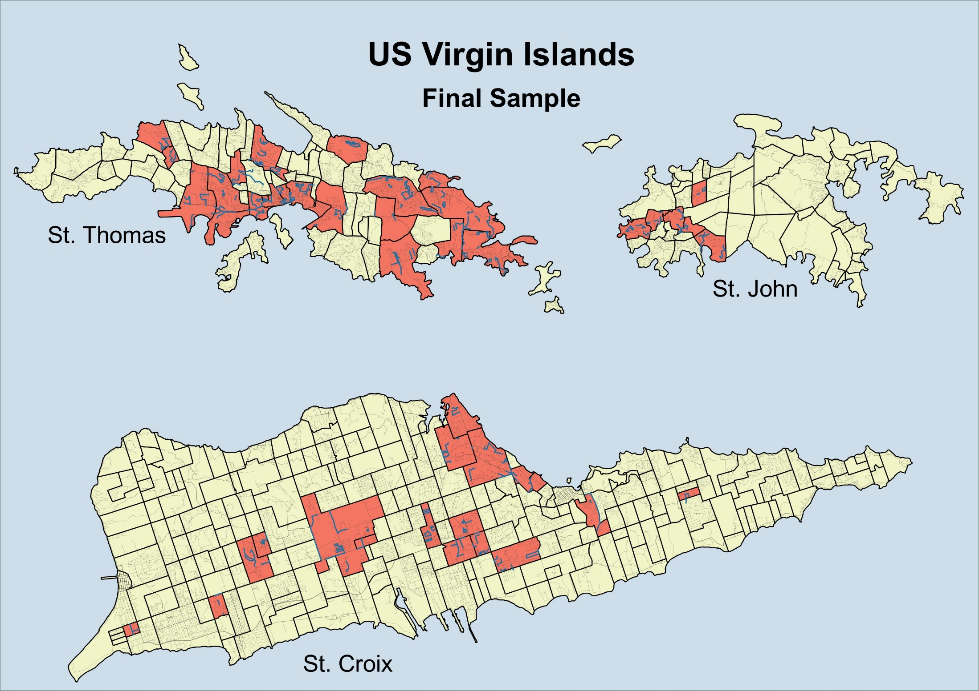
46 Estates
1550 Street Segments
99.2 km (16.2%)

Slide 20
How can data from the USVI walkability audit be used…and what are its limitations?
Potential uses
  Identify overarching needs in the territory
  Prioritize strategies for improving walkability
  Highlight existing positive features
  Provide baseline estimates that can be used to monitor change
Limitations
  Cannot identify specific sites for improvement
  No gold standard or defined benchmark for each measure

Slide 21
How can data from the USVI walkability audit be used…and what are its limitations?
Audit results | Potential uses… | Cannot tell us…
3.2% of street length in the USVI has mixed land use (residential and commercial). | Consider zoning practices that encourage mixed use development. | 20% of street length in the USVI should have mixed used development.
23.9% of street length in the USVI has speed bumps, but other traffic calming features are rare. | Highlights existing traffic calming measures, but other more effective approaches could be used to enhance pedestrian safety. | Charlotte Amalie has no traffic calming features and would be an ideal location for a traffic circle.
6.1% of street crossings in the USVI have marked crosswalks. | Consider Complete Streets approaches that design streets and crossings so they are safe and accessible for all users, including pedestrians. | Five Points intersection on St. Croix needs more visible crosswalks.

Slide 22
How can data from the USVI walkability audit be used…and what are its limitations?
Audit results | Potential uses… | Cannot tell us…
3.2% of street length in the USVI has mixed land use (residential and commercial). | Consider zoning practices that encourage mixed use development. | 20% of street length in the USVI should have mixed used development.
23.9% of street length in the USVI has speed bumps, but other traffic calming features are rare. | Highlights existing traffic calming measures, but other more effective approaches could be used to enhance pedestrian safety. | Charlotte Amalie has no traffic calming features and would be an ideal location for a traffic circle.
6.1% of street crossings in the USVI have marked crosswalks. | Consider Complete Streets approaches that design streets and crossings so they are safe and accessible for all users, including pedestrians. | Five Points intersection on St. Croix needs more visible crosswalks.

Slide 23
How can data from the USVI walkability audit be used…and what are its limitations?
Audit results | Potential uses… | Cannot tell us…
3.2% of street length in the USVI has mixed land use (residential and commercial). | Consider zoning practices that encourage mixed use development. | 20% of street length in the USVI should have mixed used development.
23.9% of street length in the USVI has speed bumps, but other traffic calming features are rare. | Highlights existing traffic calming measures, but other more effective approaches could be used to enhance pedestrian safety. | Charlotte Amalie has no traffic calming features and would be an ideal location for a traffic circle.
6.1% of street crossings in the USVI have marked crosswalks. | Consider Complete Streets approaches that design streets and crossings so they are safe and accessible for all users, including pedestrians. | Five Points intersection on St. Croix needs more visible crosswalks.

Slide 25
Thank you!
Emily: yzv4@cdc.gov
John: ydk8@cdc.gov

Slide 26
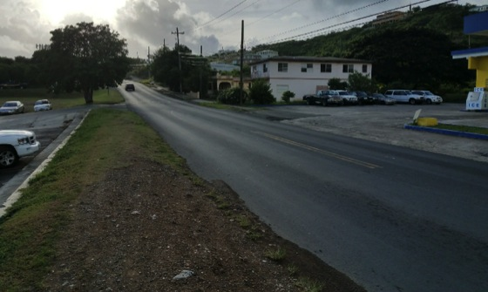
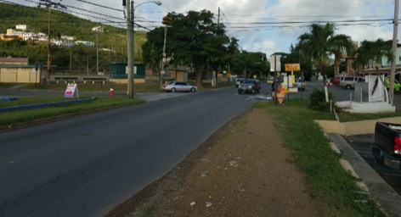
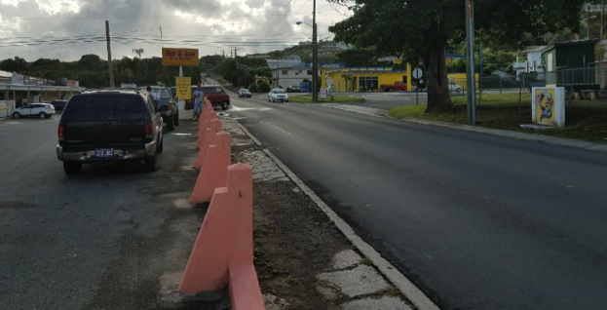
St. Croix
Demo project area.

Slide 27
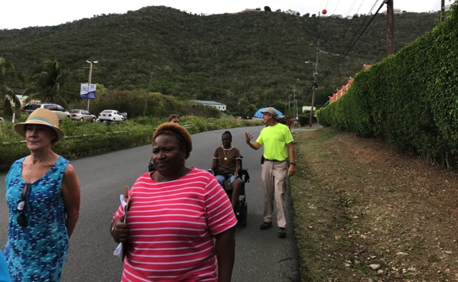
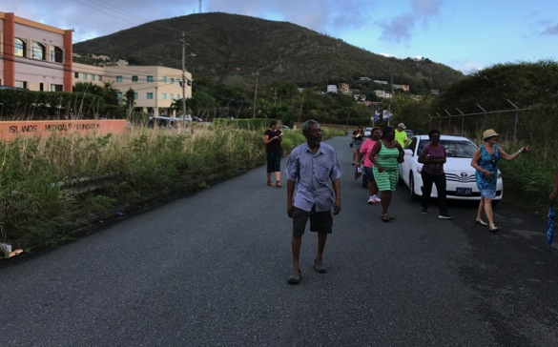
St. Thomas
Demo project area.

Slide 28
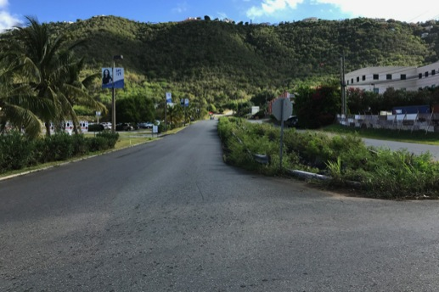
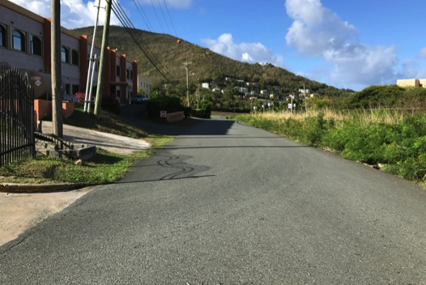
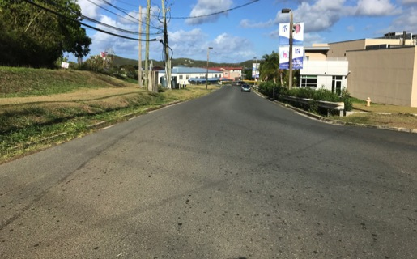

Slide 29
St. John: Fish Fry Road area

Slide 31
The challenges – finding the balance between nature & infrastructure, cost & reality, now vs. later, etc.
But you can do it!

